Slide 1


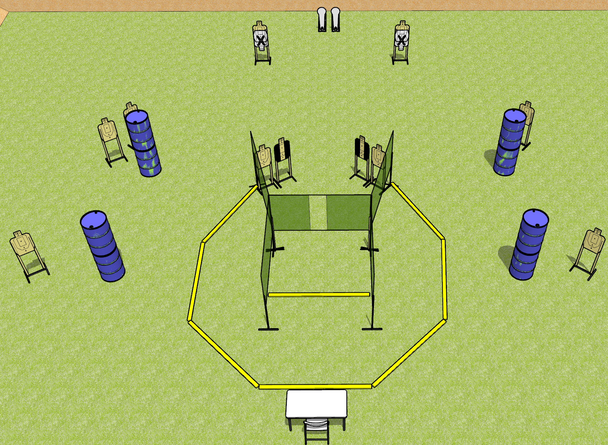
 | Dothan Gun Club – USPSA Match Boop Course Designer : Drew Coleman
START POSITION : Seated in chair with back against chair. Hands flat on knees.
GUN READY CONDITION : Firearm unloaded on table, trigger guard on a mark. First magazine to be used for stage placed on table on other mark. |  | SCORING: Comstock, 24 rounds TARGETS: 11 paper, 2 Steel SCORED HITS: Best 2 on paper, steel until down START-STOP: Audible, last shot RULES:
STAGE PROCEDURE: Engage targets as they become available from within the fault lines.

Slide 2
Boop
Written Stage Briefing
Boop is a 24 round, 120 point, Comstock field course. There are eleven USPSA targets and two colt poppers. The best two hits on paper will score, and steel must fall to score. The start signal is audible.
Start position is seated in chair, back against chair. Hands flat on knees. Firearm is unloaded with trigger guard on mark. First magazine to be used in stage is placed on other mark.
On start signal, engage targets as they become available from within the shooting area.

